Slide 1
Software Engineering
Dr. Md. Nasim Adnan

Slide 2
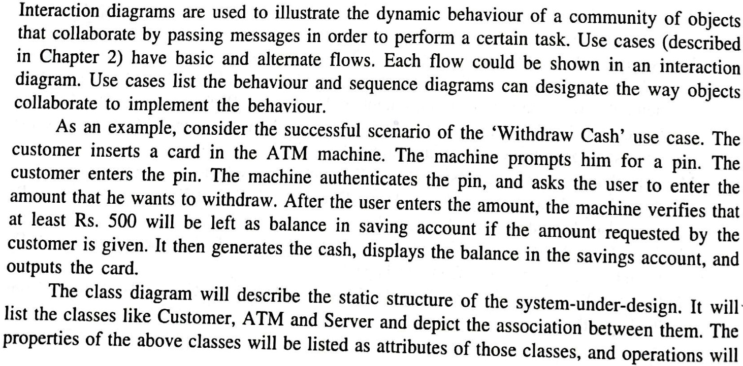
Interaction Diagram

Slide 3
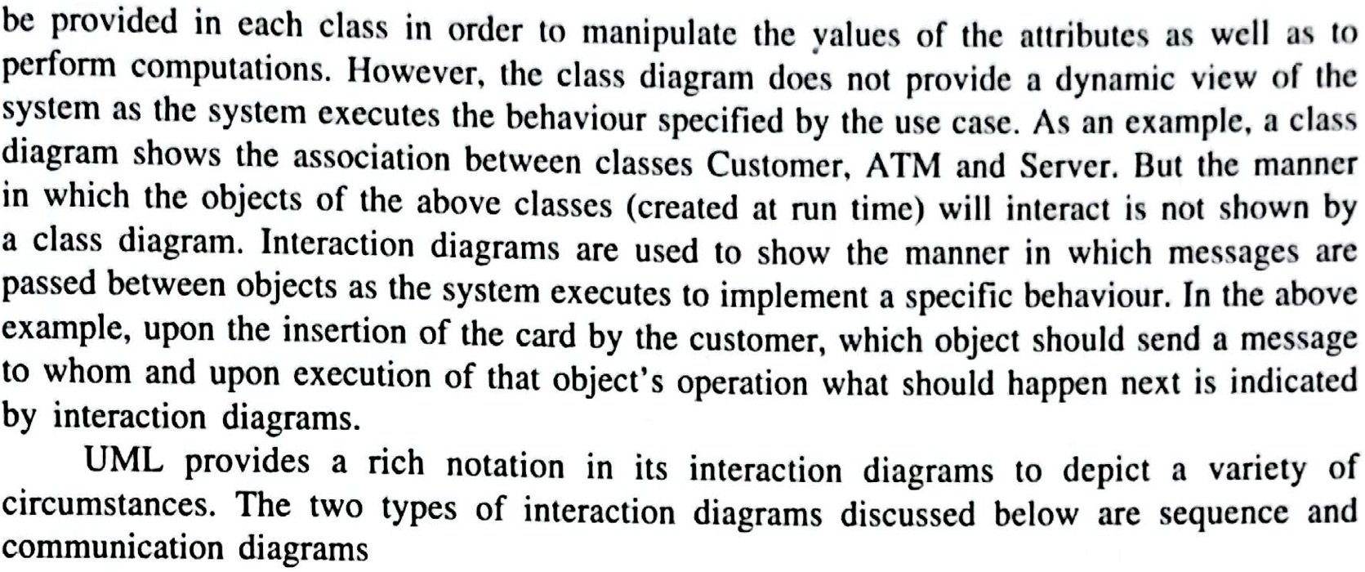

Slide 4
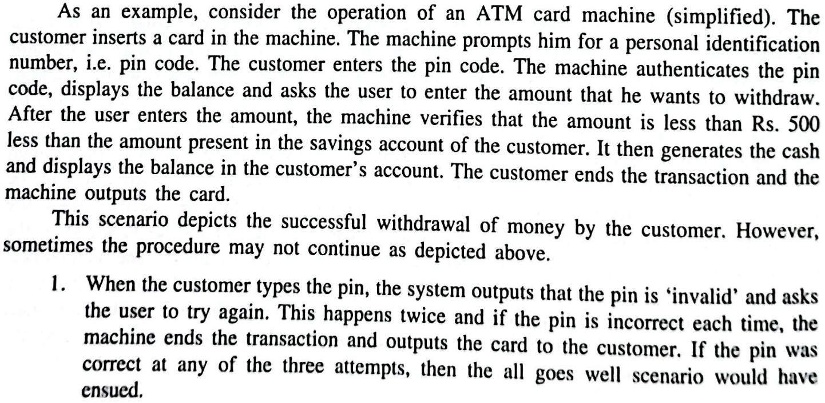

Slide 5
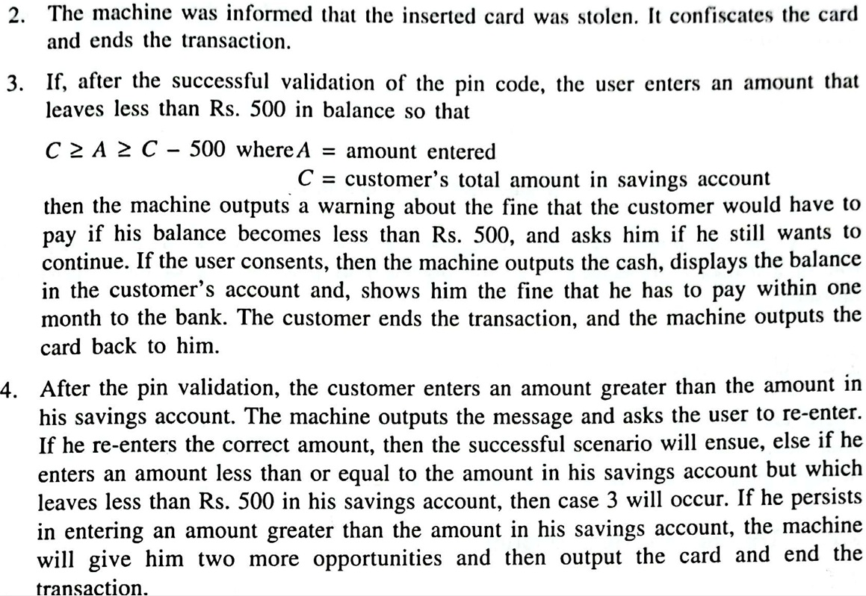

Slide 6
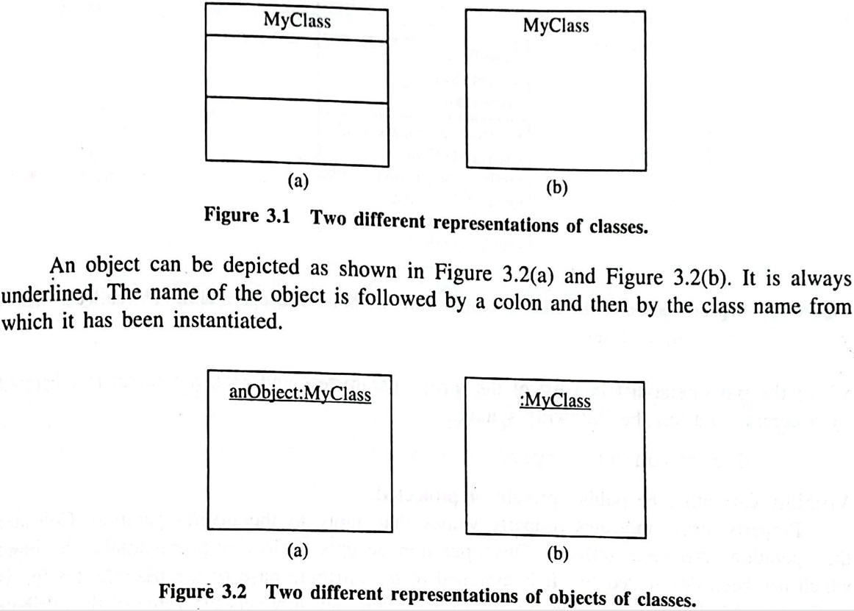

Slide 7
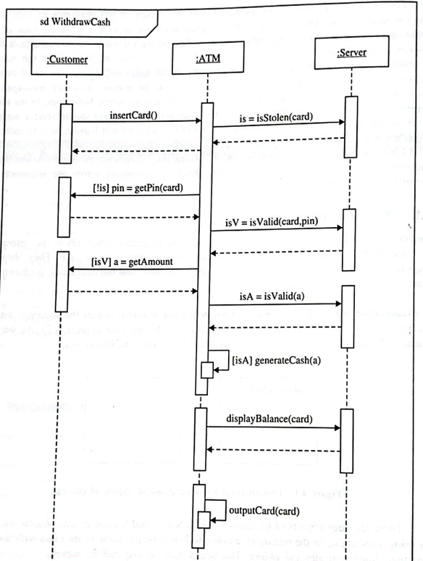

Slide 8
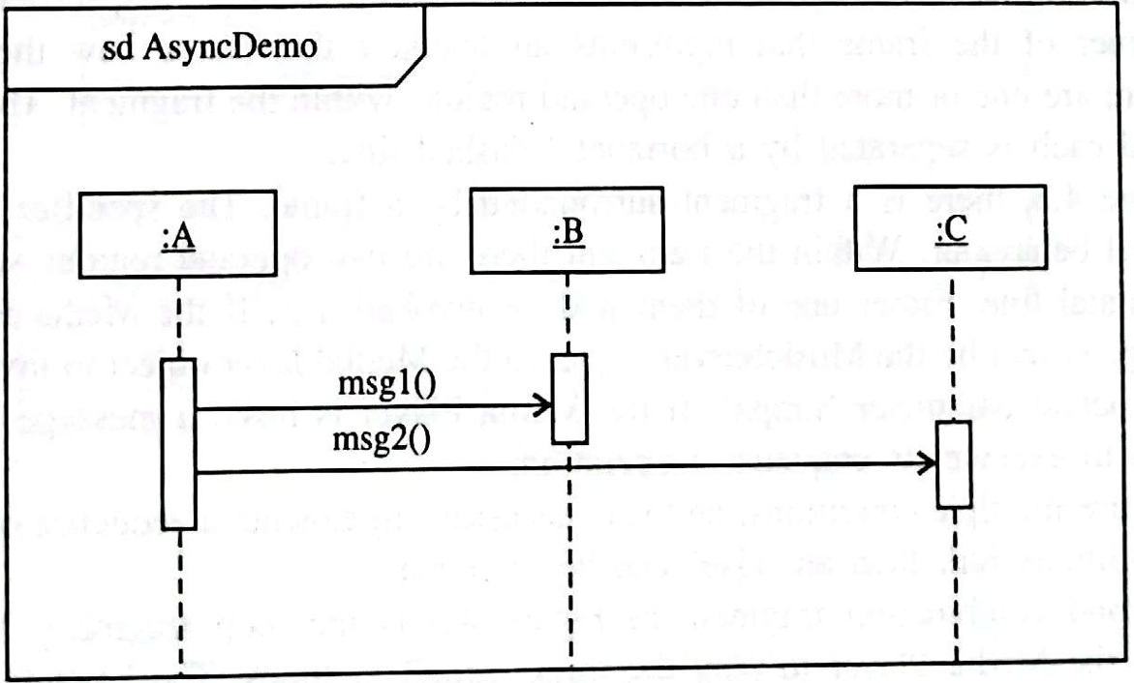
Asynchronous Messeges

Slide 9
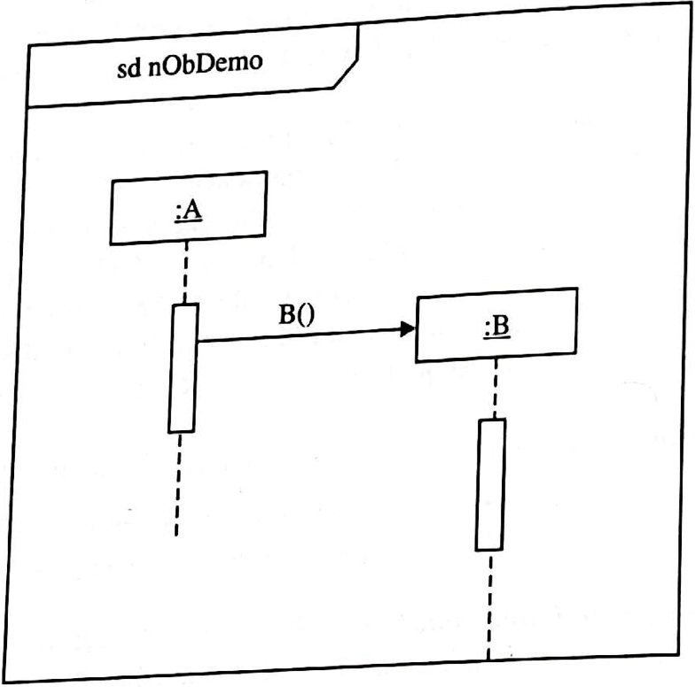
Creating New Objects

Slide 10
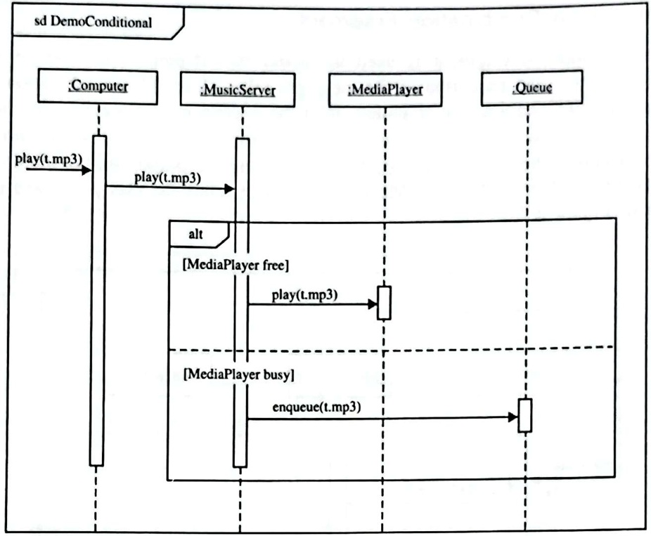
Condition and Loop

Slide 11
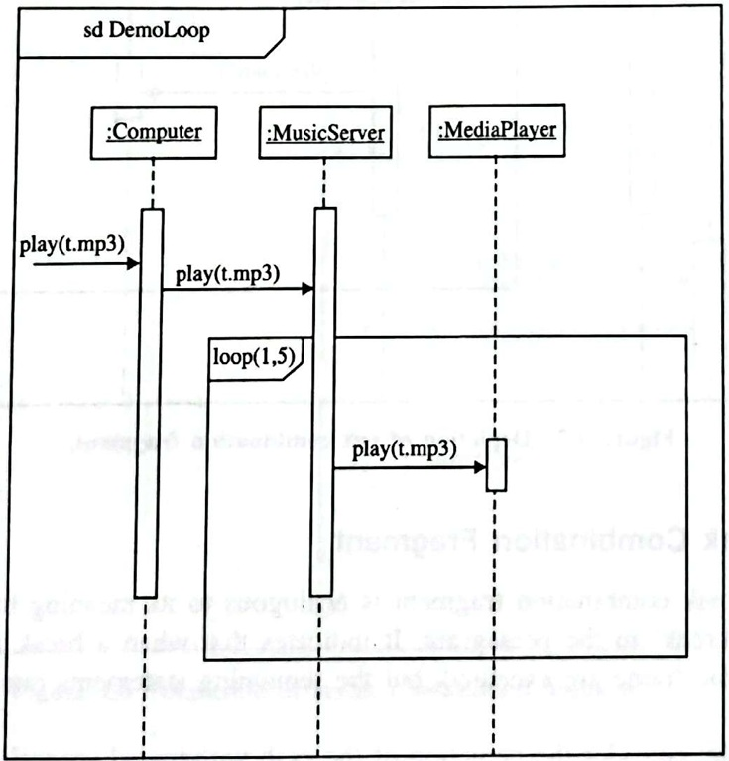

Slide 12
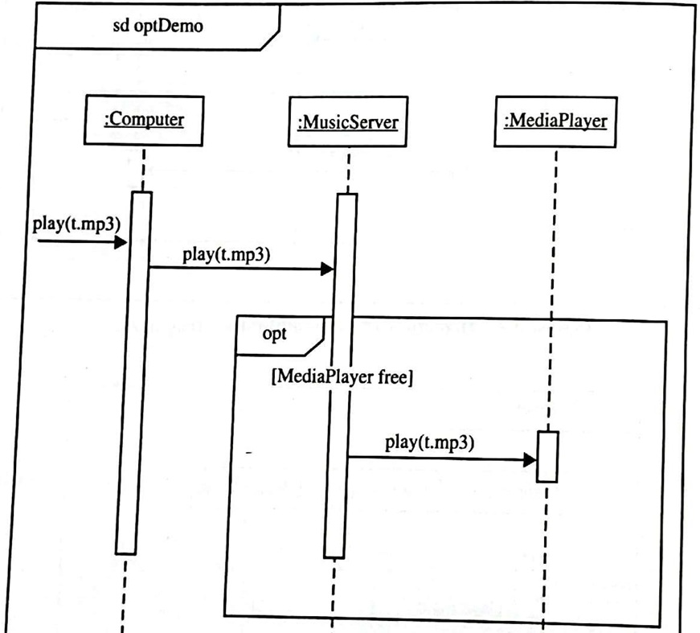
If-then Statement

Slide 13
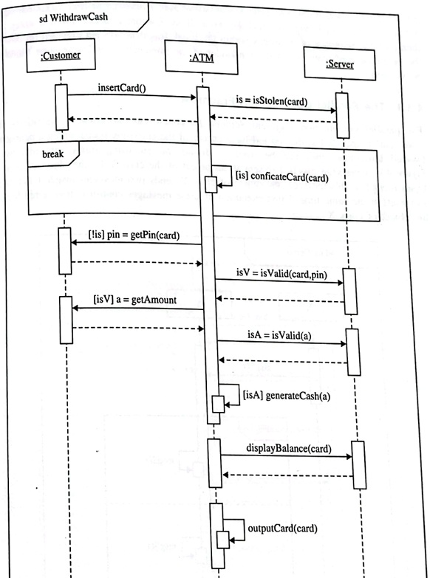
Break

Slide 14
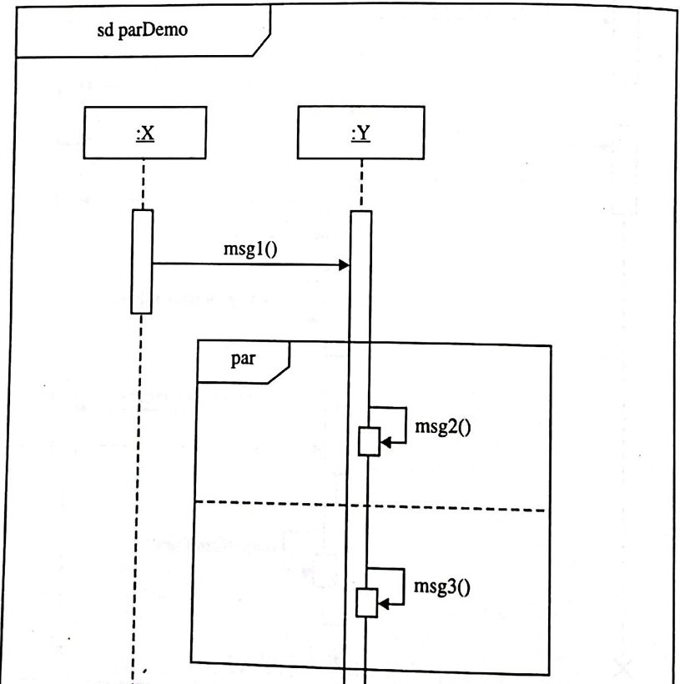
Parallel

Slide 15
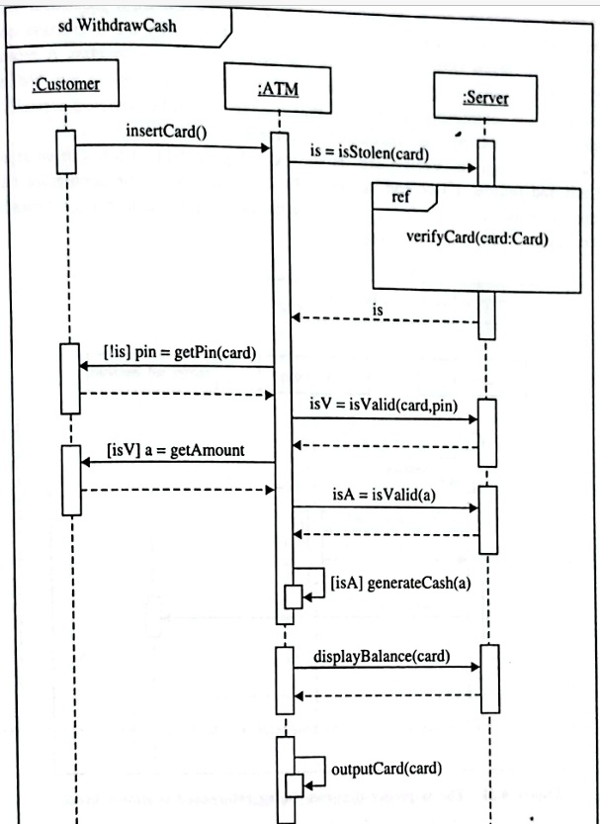
Ref

Slide 16
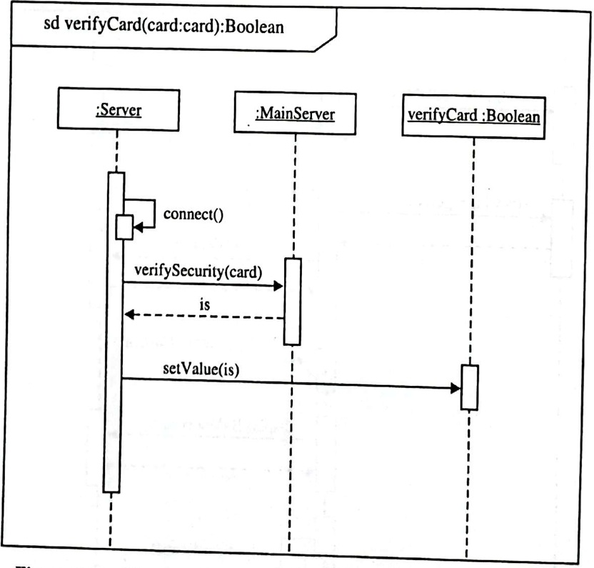

Slide 17
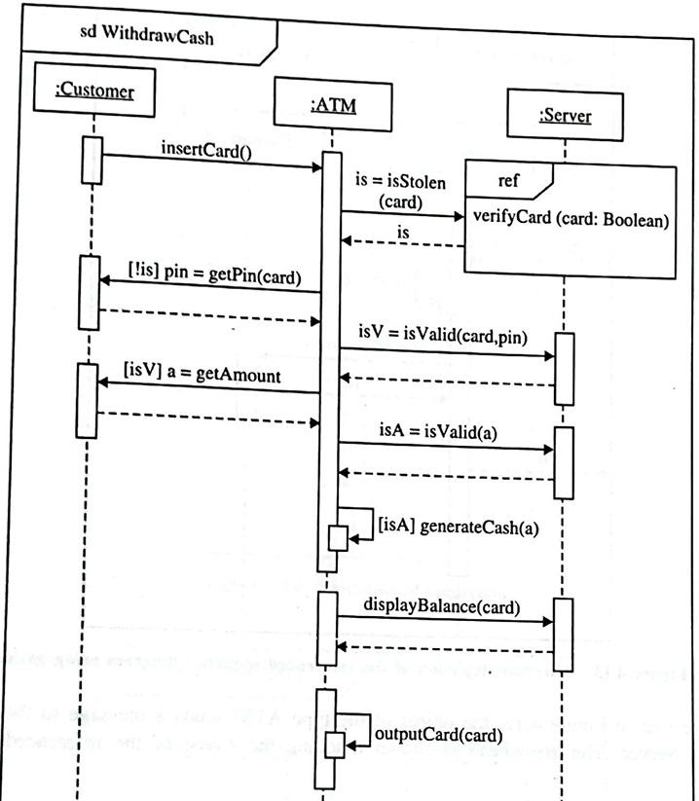

Slide 18
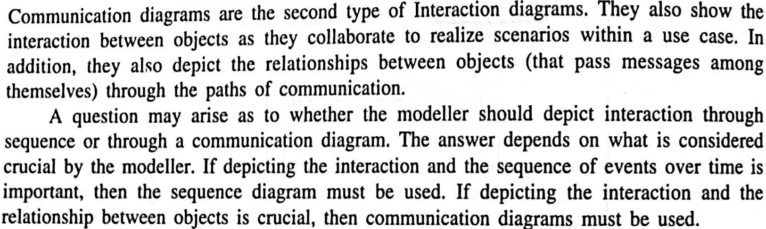
Communication Diagram

Slide 19
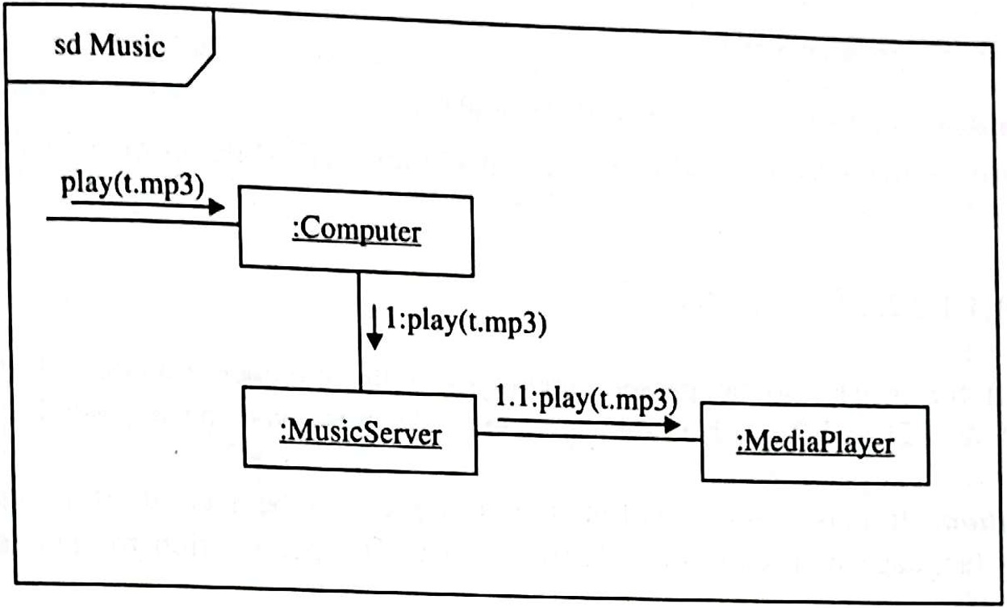

Slide 20
How to draw Interaction Diagrams
Step 1: Identify Interactions
Step 2: Create Lifelines
Step 3: Add Messages
Step 4: Review and Refine
Step 5: Validate

Slide 21


